Slide 1
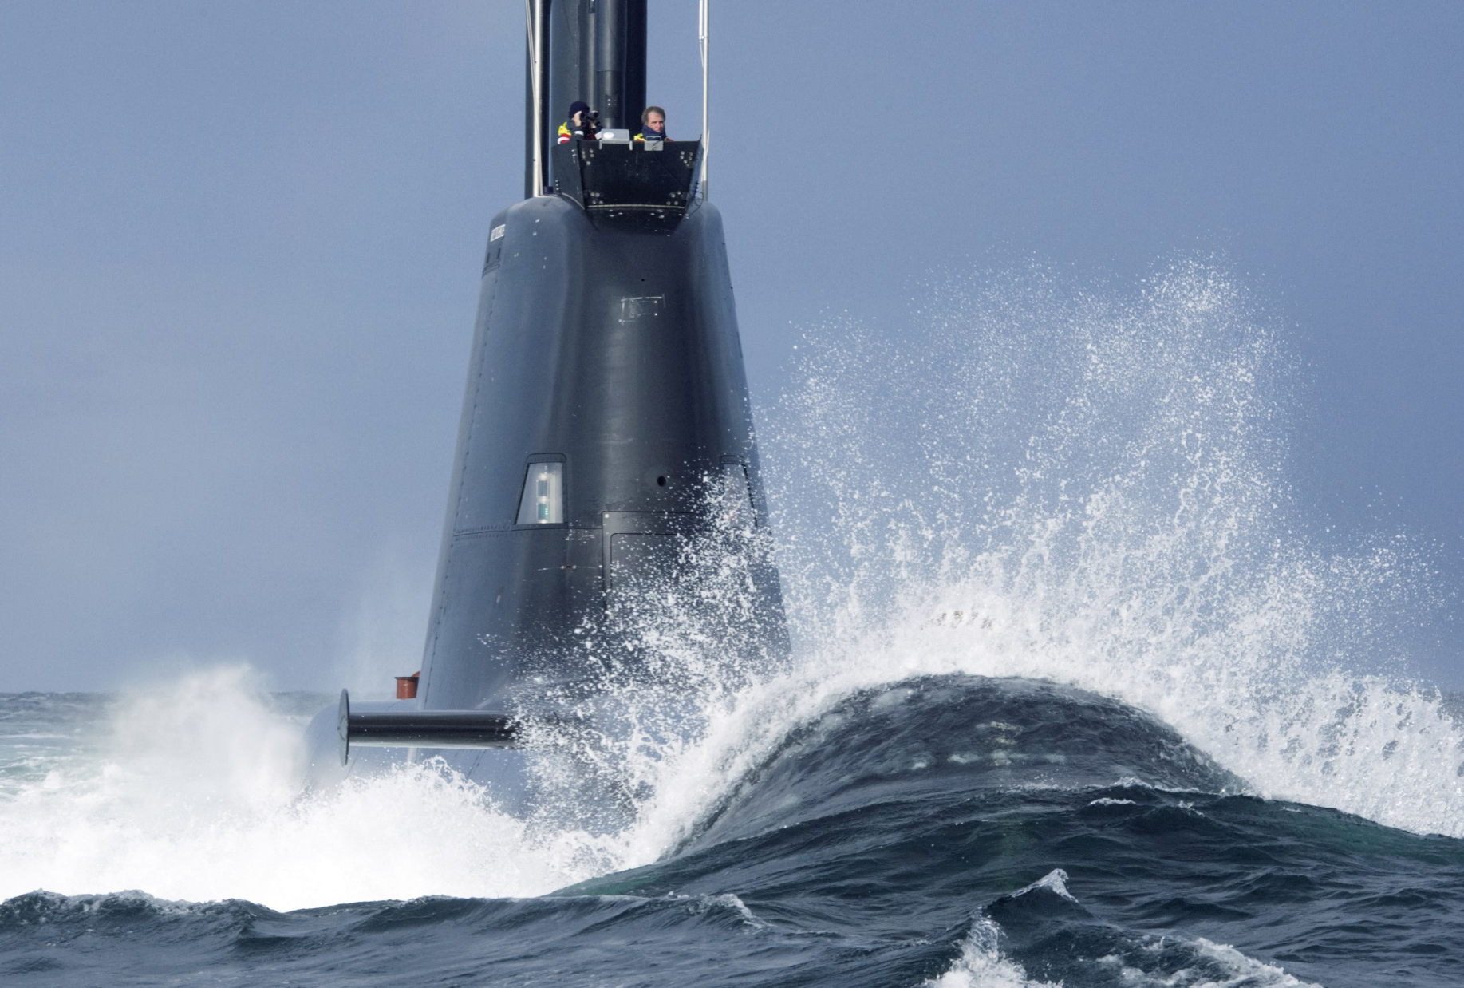
Benefits of Multinational Cooperation in the Area of Conventional Submarines
March 16th 2016

Slide 2
Benefits of Multinational Cooperation in the Area of Conventional Submarines
March 16th 2016
Capt (N) Henning Faltin
DEU MoD, BH Plg I 5
- Strategic Defence Planning & Concepts
 BMVgPlgI5@bmvg.bund.de
+49 (0) 228 – 12 – 14580
Notes:
Welcome to the 3rd International Conference on Submarine Cooperation.
Short Introduction of new Chairman
Tour de Table wahrscheinlich grundsätzlich nicht nötig ABER zumindest Capt Ammerlaan (NLD – ComSubServceNL) und TrDir Fehlhaber (AIN II3) sind neu am Tisch: → Vorschlag: kurze Runde

Slide 3
Conventional Submarine Cooperation
Number of submarines
Relative effort to maintain capability
Research & Development
Technology
Cost per unit
Modernisation
Training
In-Service-Support
Operation
∑≈ 65 Conventional Submarines in Europe (NATO: 55)

Slide 4
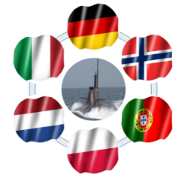
Conventional Submarine Cooperation
International Submarine Cooperation
Research
Technology
Training
Operation
ISS
DEU | 212A | 6
ITA | 212A Sauro | 4 4
NLD | Walrus | 4
NOR | 210 (Ula) | 6
POL | 207 (Kobben) Kilo | 4 1
POR | 209 PN | 2
Approximately 50% of all European conventional submarines represented
Potential to achieve “economies of scale”
Already tangible results („low hanging fruit“)
forum for ad-hoc cooperation, information exchange and coordination
Notes:
Nearly half of those submarines are represented through this rather unique format
Submarine Cooperation is a very flexible, informal setup enabling participants to cooperate very quickly based on personal contact and broader understanding of eahcothers needs and capabilities
This is the perfect forum to realize economies of scale, to realize demanding exercises, to exchange information and to profit from eachother
Being new to this group, i have the feeling that this rather unofficial setup is the most efficient way to realize economies of scale

Slide 5
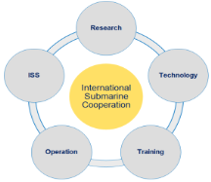
Conventional Submarine Cooperation
Field | Participants | Chair
Research | DEU, NLD, NOR Observer: PRT, ITA | DEU/ WTD 71 (Technical Centre for Ships and naval Weapons, maritime Technology and Research)
Development | DEU, NLD, ITA, NOR Observer: POL, PRT | DEU/ BAAIN Bw (Federal Office of Bundeswehr Equipment, Information Technology and In-Service Support)
In-Service Support | DEU, PRT, ITA Observer: NLD, POL, NOR | ITA/ BAAIN Bw (Federal Office of Bundeswehr Equipment, Information Technology and In-Service Support)
Operation | DEU, NLD, POL, PRT, NOR Observer: ITA | NOR
Training | DEU, NLD, POL, PRT, ITA, NOR | DEU/ AZU (DEU Submarine Training Centre)

Slide 6
Conventional Submarine Cooperation
Quick wins
Execution of Joint Torpedo Exercise
Further exchange of E&T possibilities (courses)
Coordination of Submarine Support Units
Longer run
Establishment and E&T of common SEC/SAT
Closer linkage between E&T, development of SOPs and R&D
Enlargement of DEU-ITA MoU on In-Service-Support (PRT)
E&T Education & Training
SEC/SAT Submarine Element Coordinator/Submarine Advisory Team
SOP Standard Operating Procedure
R&D Research & Development

Slide 7
Conventional Submarine Cooperation
Way ahead
Definition and delineation of workload within the fields of R&D.
Identification of communalities throughout different systems as basis for better mutual ISS.
Chances
Higher communality of and similarity in systems will boost effects in all five fields of cooperation.
European submarine standard as chance for integration of capabilities, effective burden sharing and future-oriented sustainability.
R&D Research & Development
ISS In-Service Support

Slide 8
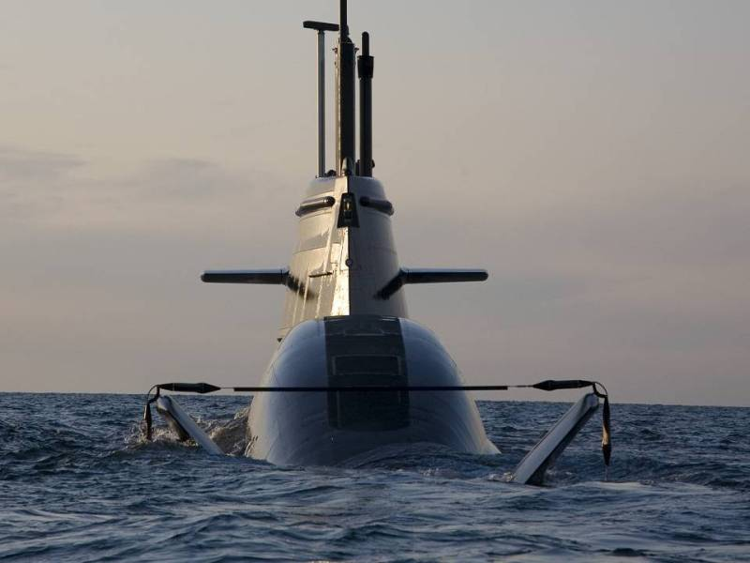
DEU – NOR Cooperation to introduce and sustain a future Submarine Capability

Slide 9
German-Norwegian Cooperation
Aim
Long-term cooperation based on identical platforms to exploit benefits in the planning and procurement phase as well as throughout the whole service life.
Benefits
coordination of R&D in development phase, expertise from various stakeholders
economies of scale in procurement phase
common ISS-organisation (spare parts, upgrades, updates,…)
coordinated E&T and R&D
Submarine Support Unit
Exercises & Operations
R&D Research & Development
ISS In-Service Support
E&T Education & Training

Slide 10
German-Norwegian Cooperation
aligned requirements
aligned technical specifications
basis for efficient long-term cooperation (identical platform)
economies of scale, learning curve
spare-parts-pool, user-groups, harmonized updates/-grades
efficient sharing of resources
Joint procurement
Joint ISS over life-time (30+ yrs)
coordinated R&D, E&T,..
ISS In-Service-Support
R&D Research & Development
E&T Education & Training
?

Slide 11
???
Capt (N) Henning Faltin
DEU MoD, BH Plg I 5
- Strategic Defence Planning & Concepts
 BMVgPlgI5@bmvg.bund.de
+49 (0) 228 – 12 – 14580

